Slide 1
Data Warehousing Week 3

Slide 2
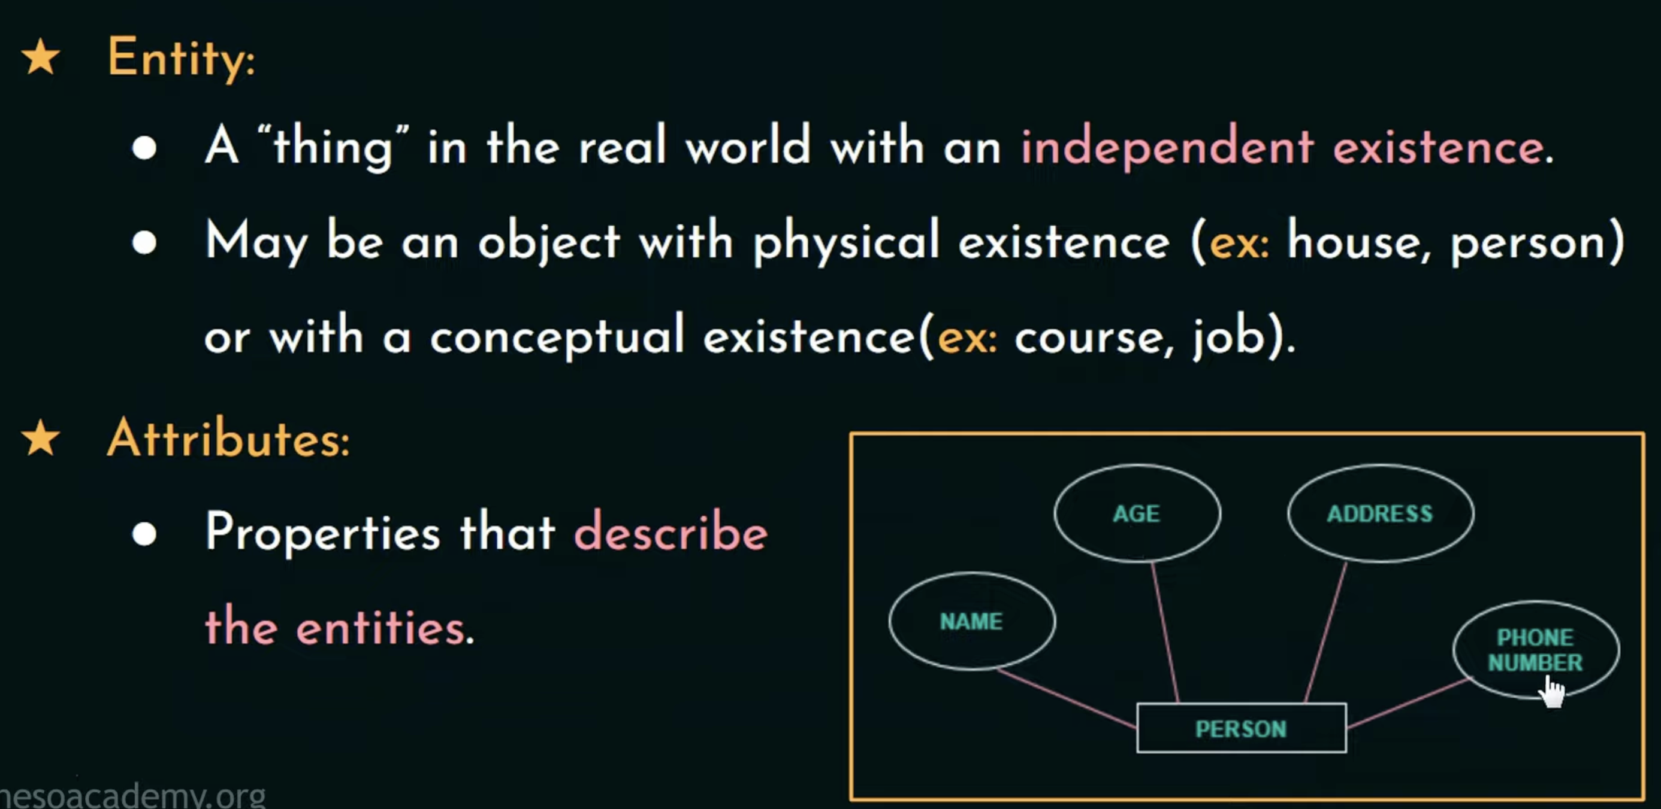
Terminologies

Slide 3
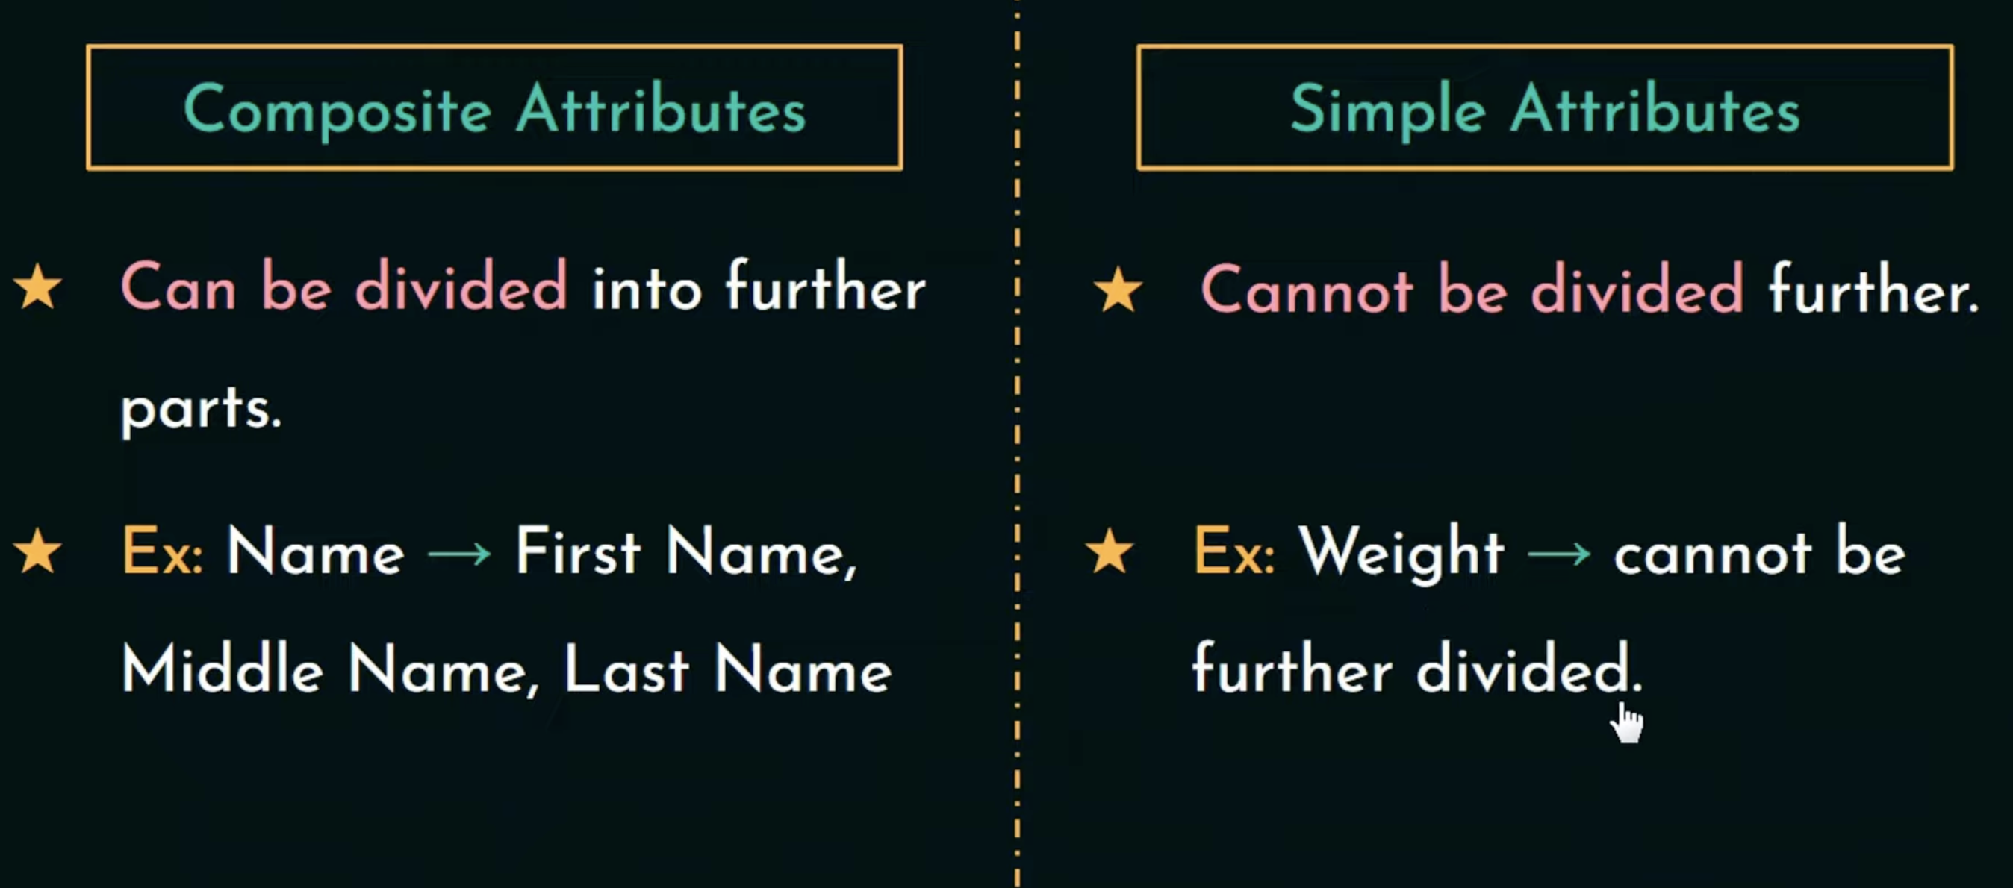
Terminologies

Slide 4
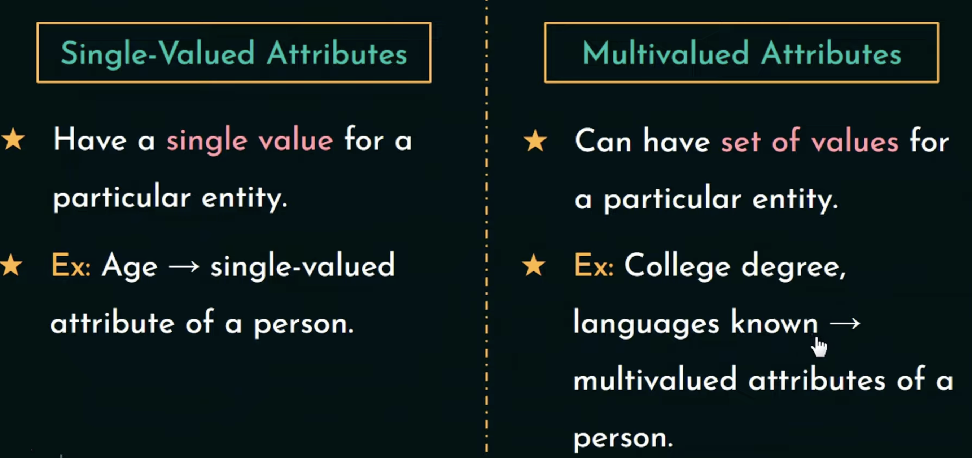
Terminologies

Slide 5
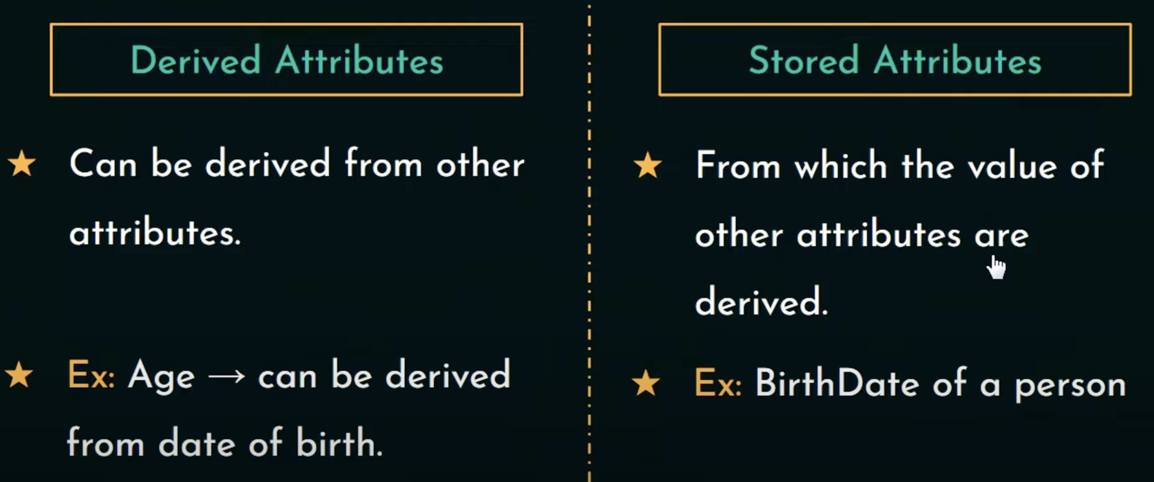
Terminologies

Slide 6
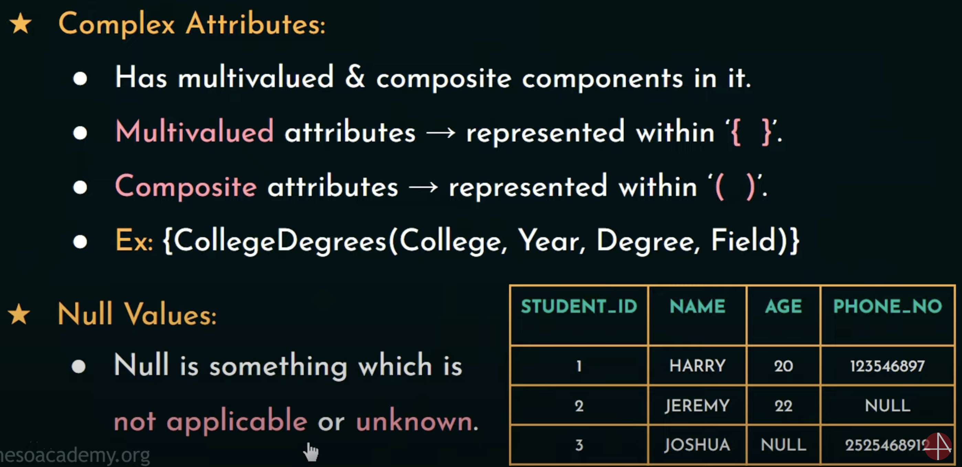
Terminologies

Slide 7
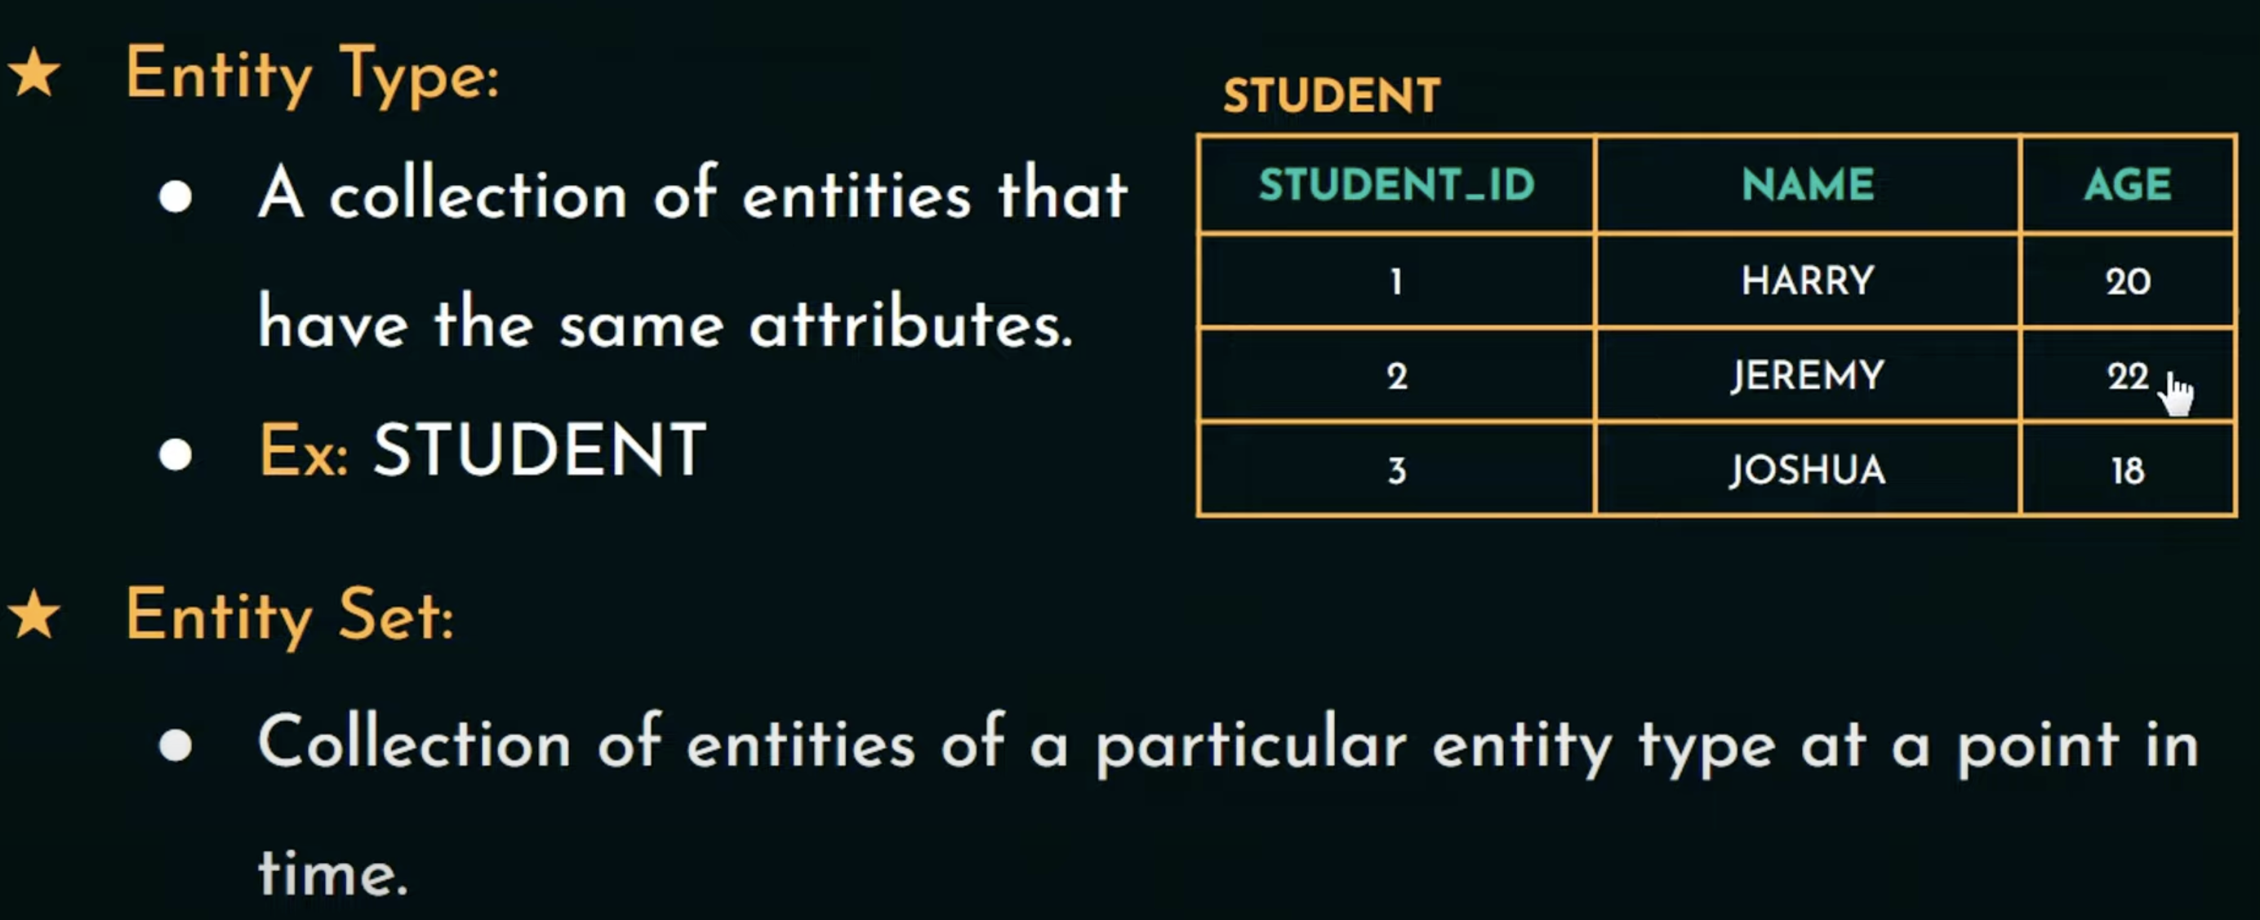
Terminologies

Slide 8
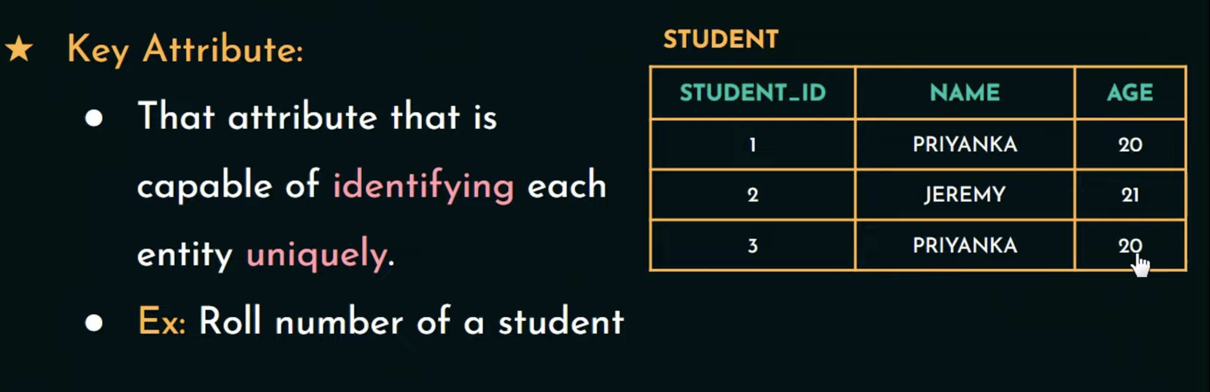
Terminologies

Slide 9
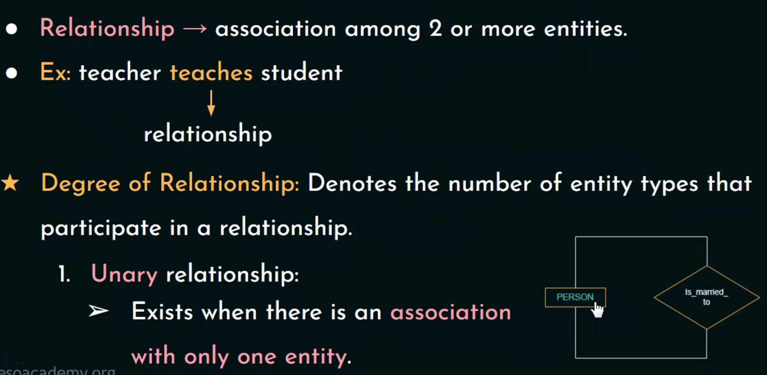
Relationships

Slide 10
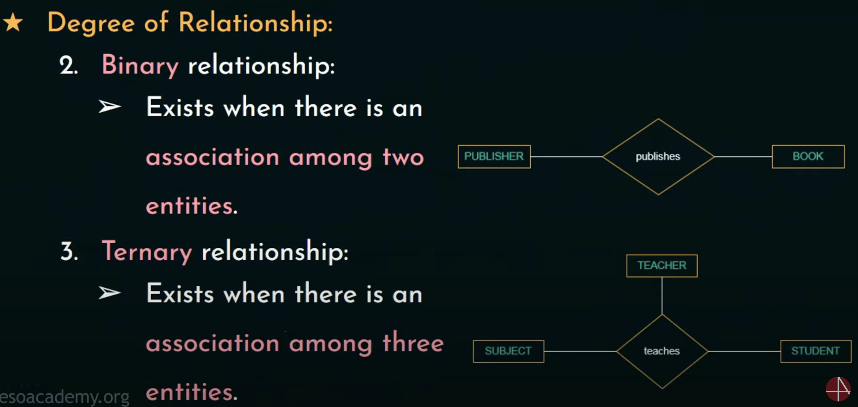
Relationships

Slide 11
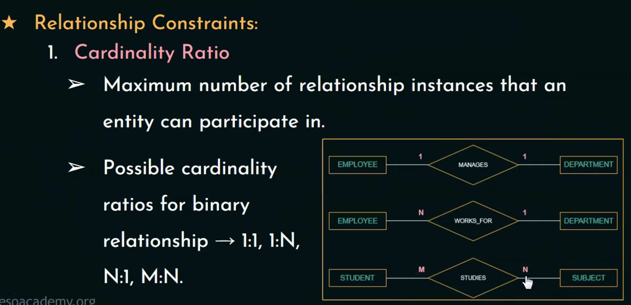
Relationships

Slide 12
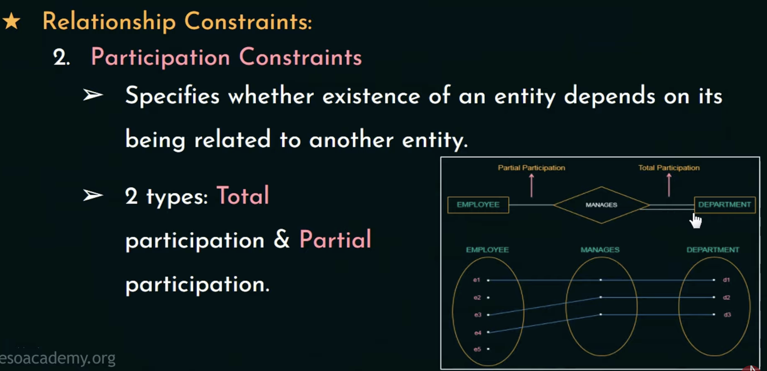
Relationships

Slide 13

ER Diagram for Company Database

Slide 14
ER diagram - Activity
Design an E-R diagram for keeping track of the exploits of your favorite sports team, You should store the matches players, the scores in each match, the players in each match and individual player statistics for each match. Summary statistics should be modeled as derived attributes.

Slide 15
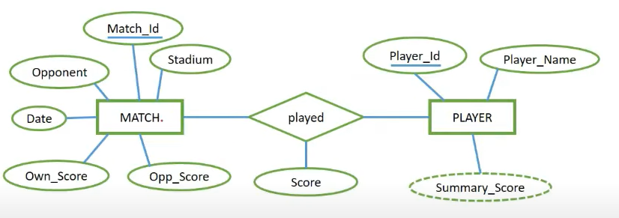
Example

Slide 16
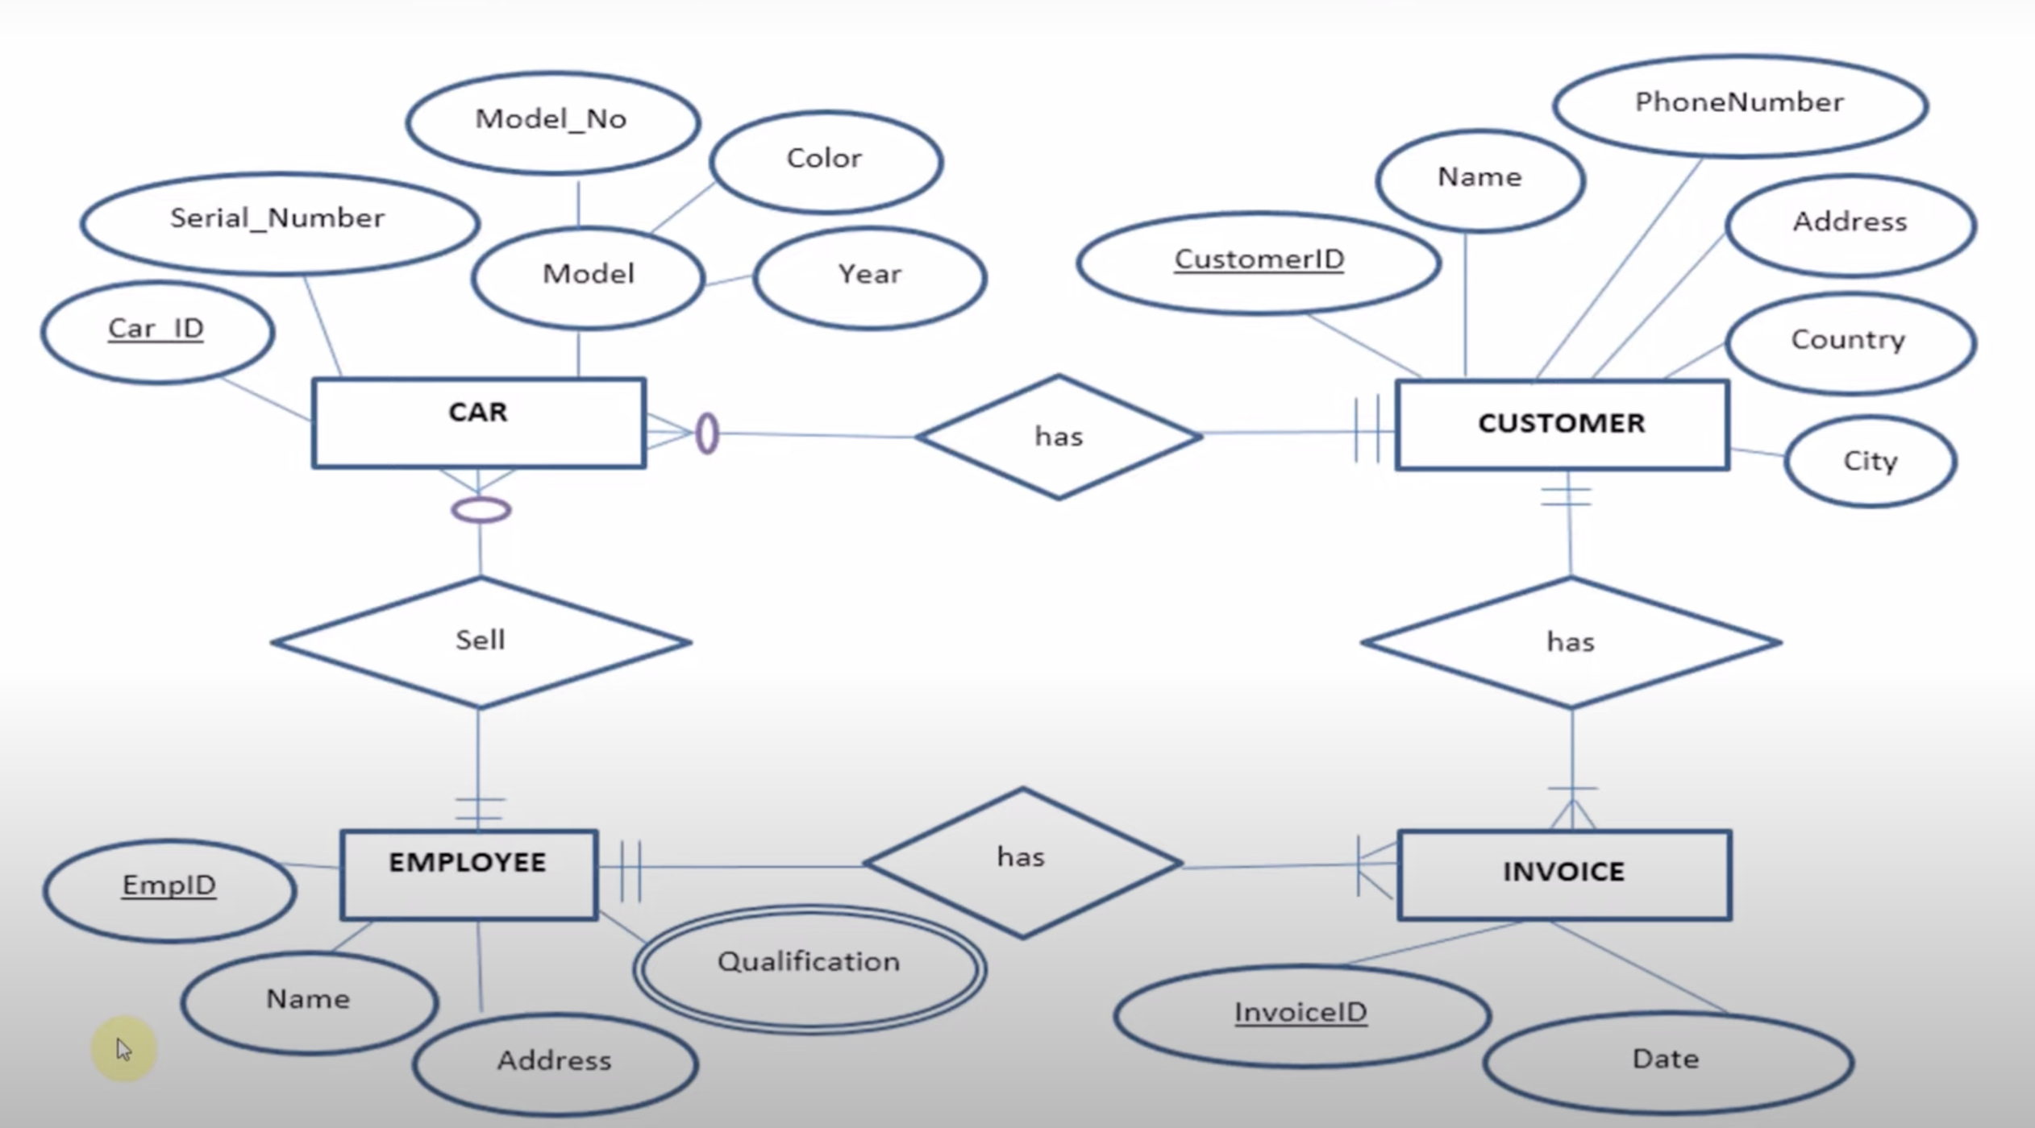
Transform ERD to Relational Schema

Slide 17
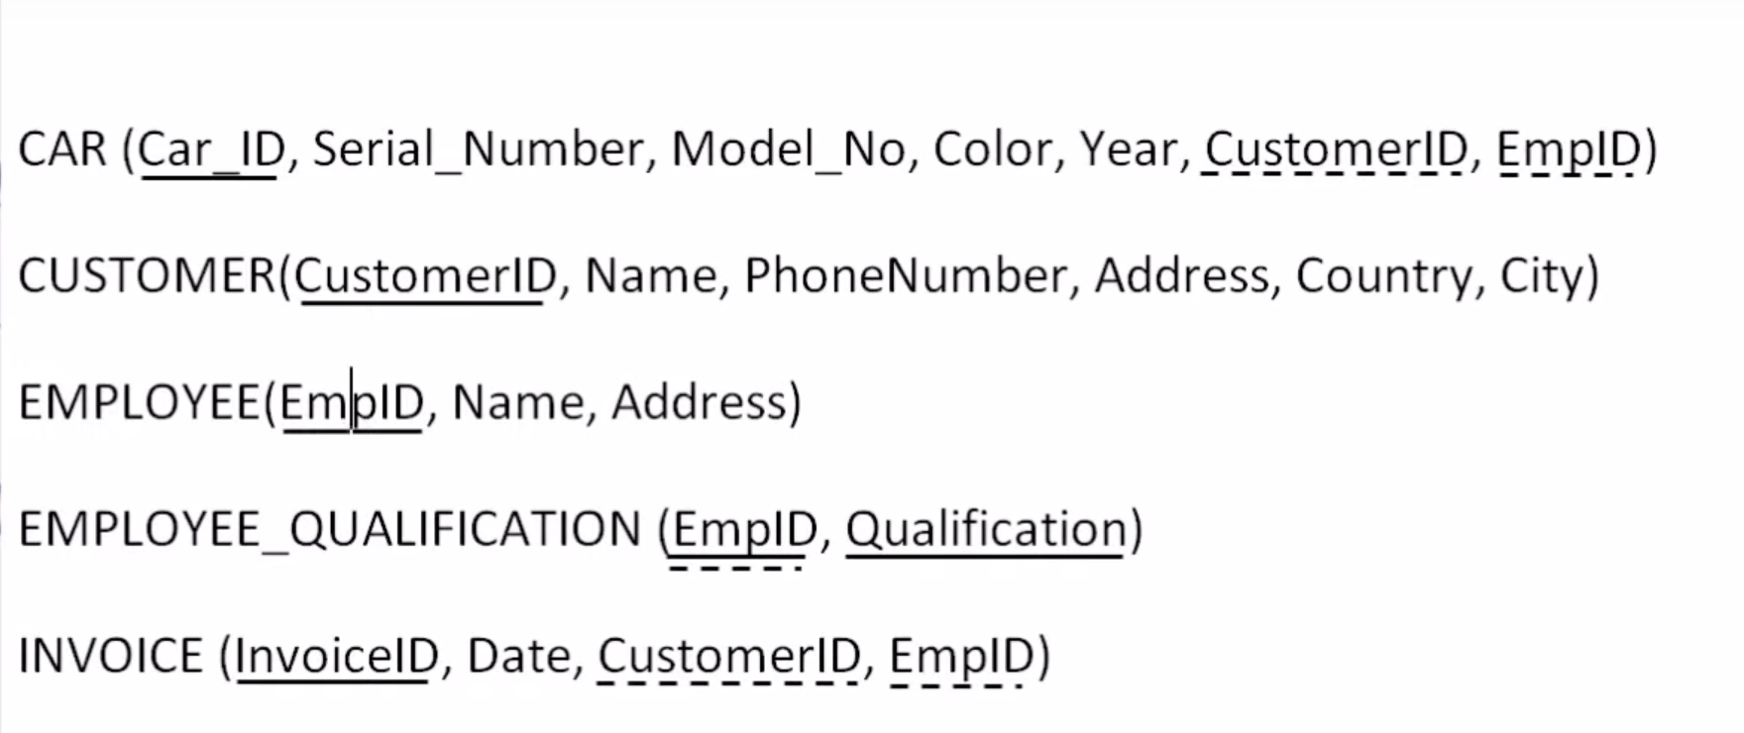
Transform ERD to Relational Schema

Slide 18
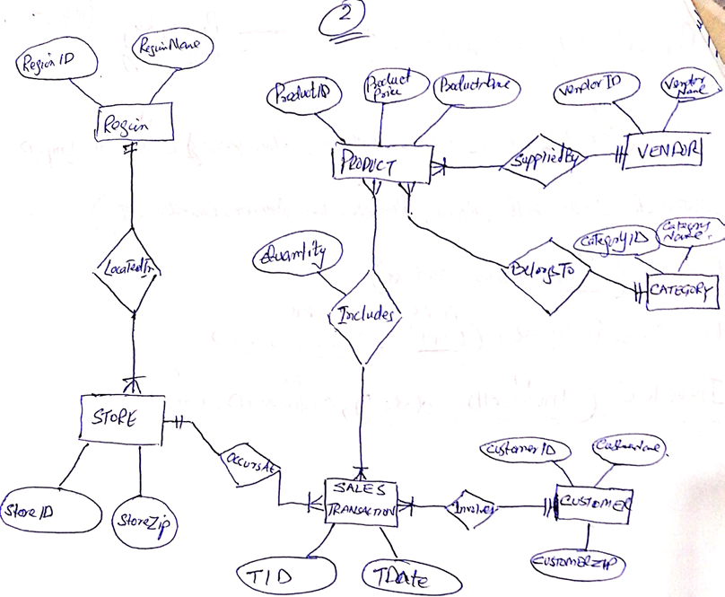
Task

Slide 19
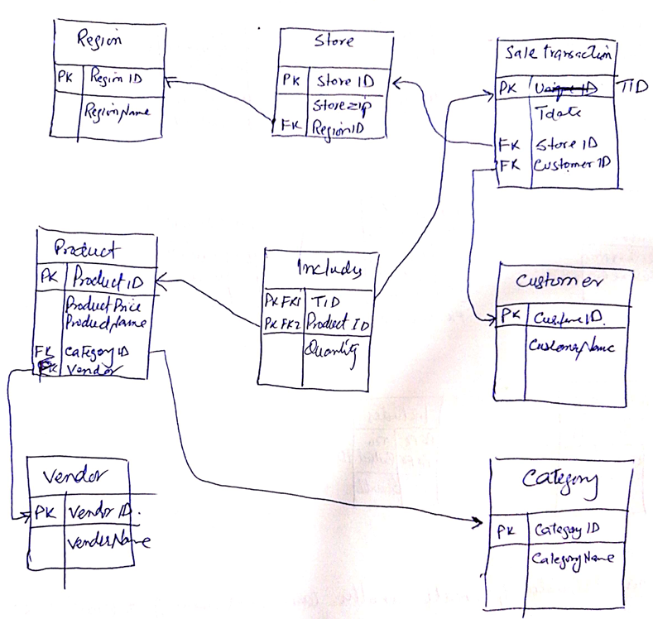
Solution

Slide 20
